Slide 1

Natural language processing
LUÍS FIUNTE · JOÃO GUEDES

Slide 2
introduction
This project utilizes the Hugging Face ADS509/full_experiment_labels dataset.
It is a text classification dataset containing a collection of opinionated text snippets and social commentary, already partitioned into standard training (49,268 examples), validation (10,557 examples), and testing (10,558 examples) splits.
The dataset consists of social media comments focused on political discourse. Data was collected by querying for "politics" or "US Politics" across five distinct online platforms: YouTube, Hacker News, MetaFilter, Reddit, and BlueSky. The collection timeframe spans from 2024 to mid-February 2026.
The dataset features five distinct classes, mapping conversational intents to integer labels:
Neutral (0): Clarifying questions, meta-commentary, or off-topic remarks.
Opinion (1): Value judgments or stances without substantial reasoning.
Argumentative (2): Specific claims or assertions supported by reasoning, evidence, or anecdotes aiming to persuade.
Expressive (3): Emotional reactions, sarcasm, venting, or performative agreement/disagreement.
Informational (4): Sharing facts, data, links, or context with low emotional affect.
The creators of the dataset applied several initial cleaning steps before publication. Approximately 2,000 to 3,000 duplicate comments and all NaN values were removed. The text underwent standardization: emojis were converted into text representations, all text was lowercased, HTML artifacts were stripped, URLs were replaced with a generic [URL] tag, and escaped characters (e.g., ") were converted back to standard text.

Slide 3
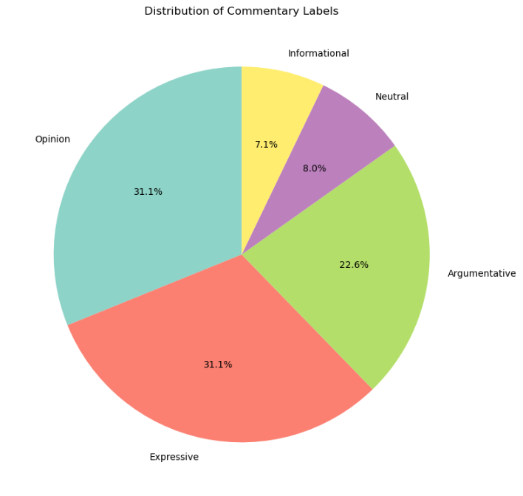
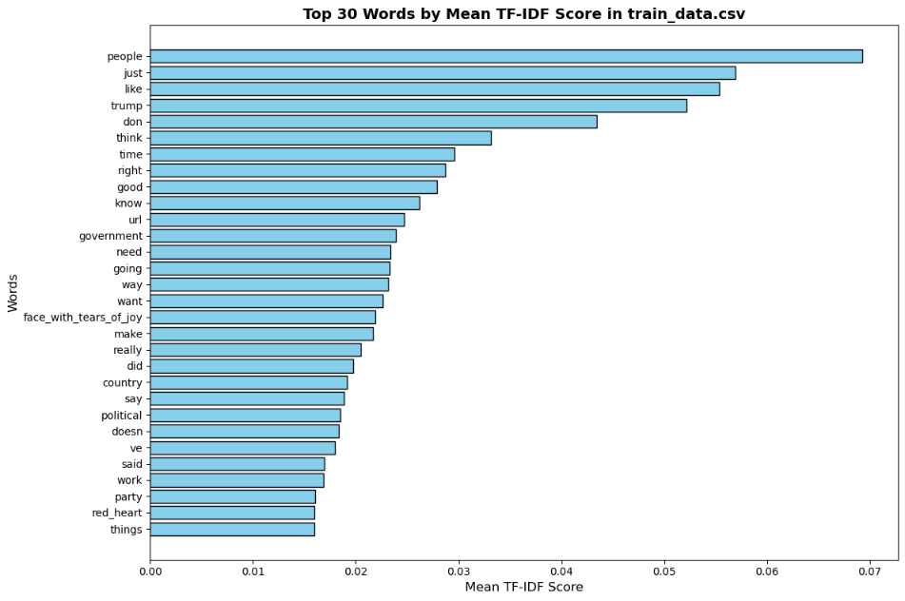
EDA

Slide 4
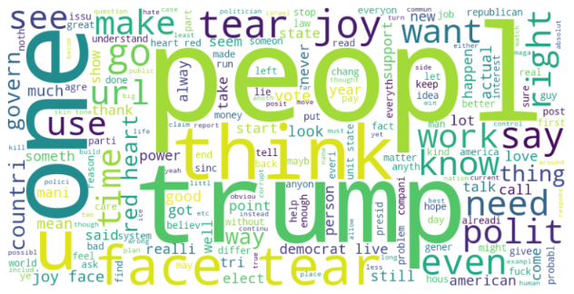
PRE-PROCESSING
Lowercasing & Non-alphabetical Removal: Standardizes the text and removes noisy punctuation that doesn't contribute to the core sentiment or argument.
Stopword Removal: Filters out highly common but semantically uninformative words (like 'the', 'is', 'and') to reduce noise and dimensionality.
Stemming (PorterStemmer): We chose the PorterStemmer for its computational efficiency and simplicity. Social media data is often highly informal, noisy, and prone to grammatical errors. The Porter Stemmer uses a well-established set of heuristic rules to strip common morphological endings, collapsing variations of words (e.g., "argue", "arguing", "argued") into a single base feature. While lemmatization is an alternative, it requires accurate Part-of-Speech (POS) tagging which often struggles with internet slang, making the lightweight and robust PorterStemmer a sensible choice for this dataset.
We only used this pre-processing on BoW (Bag of Words), TF-IDF, N-Grams, Hashing, LSA, and CustomW2V.
Pre-trained Dense Embeddings (Word2Vec / FastText via spaCy): These models expect raw, natural sentences. Applying aggressive stemming or stopword removal strips away the syntactic context they need to properly map words to their pre-calculated vector spaces.
Linguistic: This component must receive the raw, untouched text to function correctly. Stripping the text would destroy the punctuation (exclamation and question marks) and capitalization metrics required by the Linguistic extractor.

Slide 5
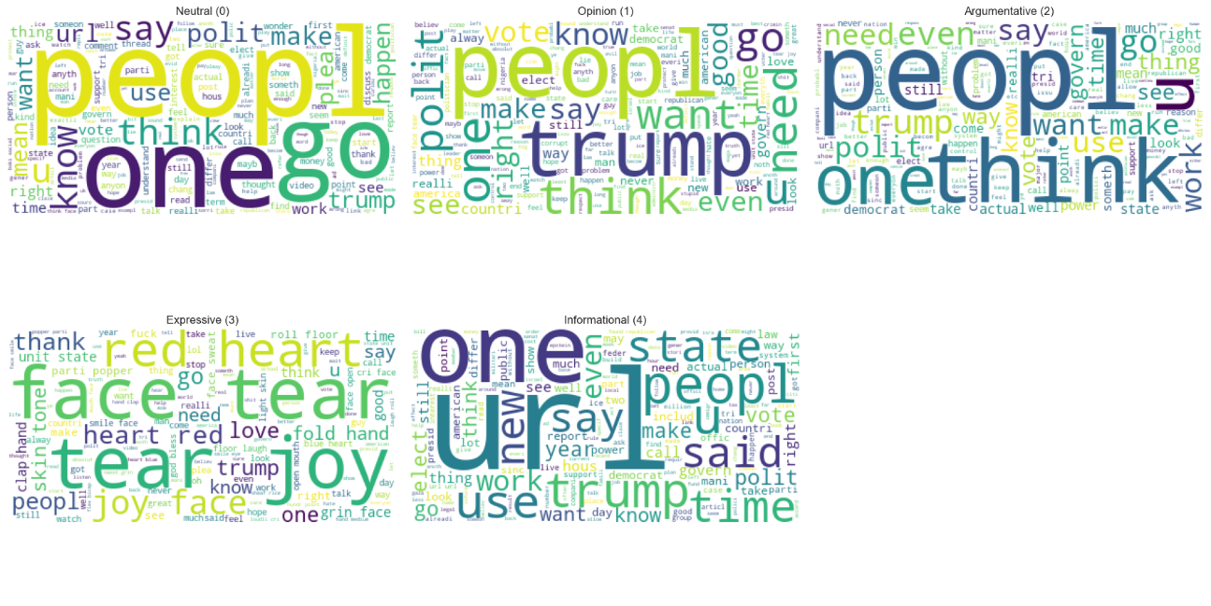
Wordcloud per label

Slide 6
feature representation AND MODELS
Models used:
LogReg
SVM_OVR
Naive Bayes
SentimentLDA
Hidden Markov Model
KNN
XGBOOST
AdaBoost
Embedding methods used:
Sparse representations
BoW - CountVectorizer
TFIDF - TfidfVectorizer
Ngrams - ngram_range=(1, 3) with TfidfVectorizer
Hashing - HashingVectorizer (10k collumns)
Dense Semantic embeddings
Latent Semantic Analysis – TF-IDF into TruncatedSVD (100 dense topic features)
Word2Vec / FastText – both using same Spacy pipeline (en_core_web_md)
CustomW2V - used Gensim to train a 100-dimensional Word2Vec from scratch
Heuristic / Engineered Features
Linguistic – total length, word count, “!”,”?”, caps.
Exceptions:
Naive Bayes (only with BoW, Hashing, Ngrams, TFIDF) – Naive Bayes doesn’t allow negative numbers
SentimentLDA (only with BoW, Ngrams) – SentimentLDA only works with “raw integers” (word “apple” appeared 3 times), doesnt work with decimal weights
HMM (skipped Hashing, BoW, TFIDF, Ngrams) – depends on variance (only works with dense vectors)
KNN (skipped BoW, Ngrams, Hashing) – distance calculation problem and curse of dimensionality (similar to HMM)

Slide 7
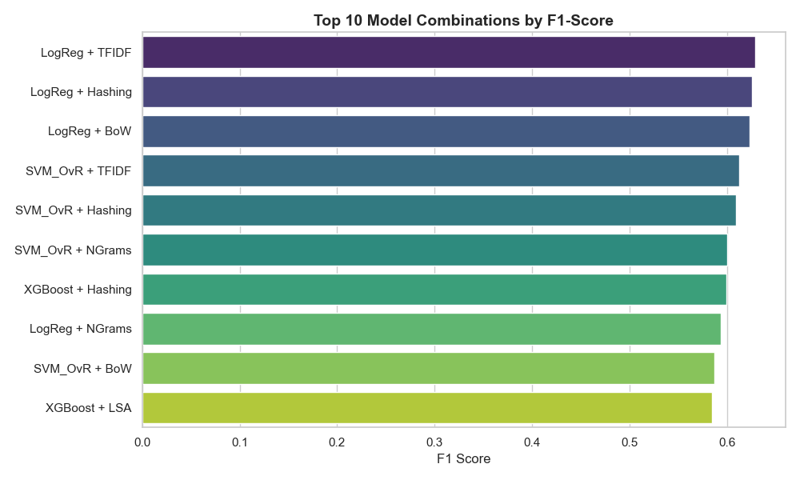
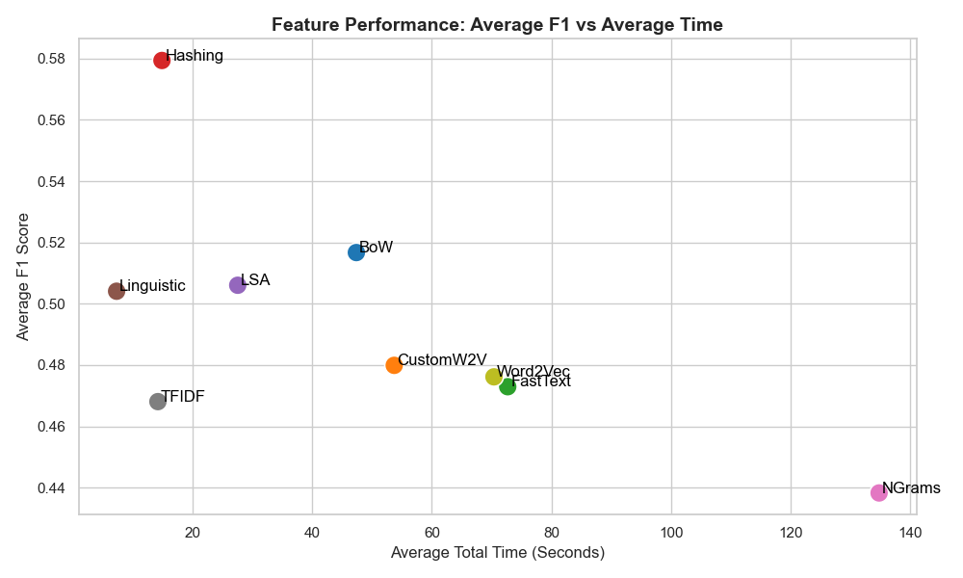
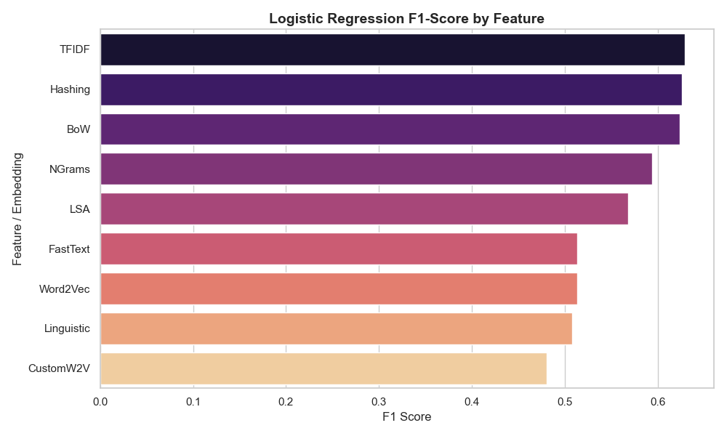
Results

Slide 8
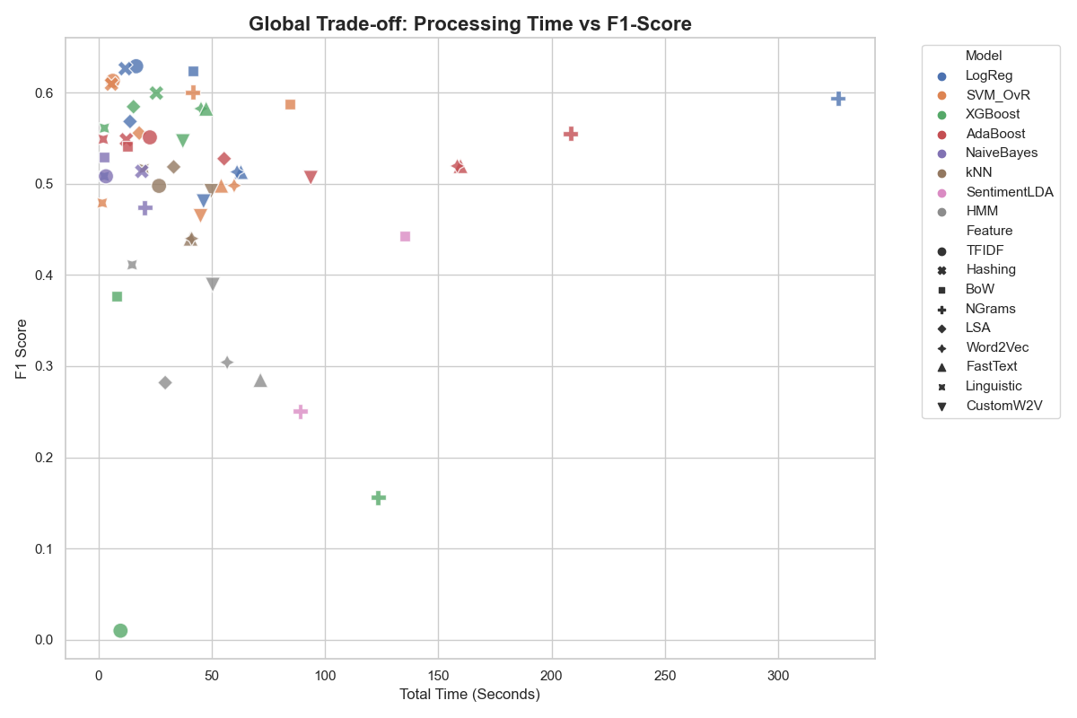
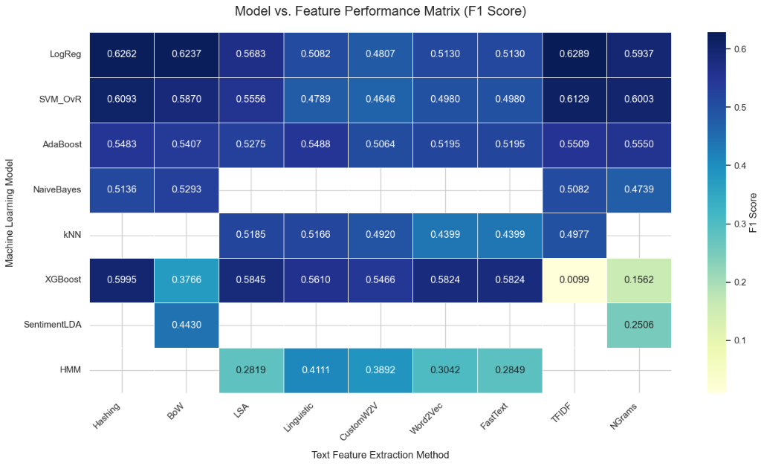
results

Slide 9
ERROR ANALYSIS
Best results come from Linear Models + sparse representations. Sparse representations -> massive grid of +10k collumns -> data points naturally spread far apart -> problem more linear separable. LinearSVM and LogReg are designed to draw hyperplanes across high dimensional spaces. They don’t overthink like more complex models.
Hashing destroyed every other representation type: social media data is incredibly noisy (slang, typos, weird capitalization), because hashing groups strings into buckets it becomes robust to noise while still being a sparse representation which makes it the best feature representation possible for this problem.
Ngrams was terrible: Ngrams failed because they are the mathematical opposite of Hashing: while Hashing succeeds by constraining the feature space into 10,000 noise-absorbing "buckets," N-grams trigger a combinatorial explosion of columns that lead the highest average time (7x more than Hashing’s time). This hyper-sparsity where unique 3-word phrases in noisy social media text appear only once forces the model to overfit.

Slide 10
ERROR ANALYSIS
XGBoost horrible on sparse representations: How can decision trees find where to split when a TF-IDF matrix is 99% zeros?
Short text consequences. SentimentLDA was poor, HMM was poor. LDA requires words co-occurently frequently within the same document to find topics (lda = clustering), and HMM is designed for identifying continuous sequences in a same document, a 15 word YouTube comment just doesn’t work.
Linguistic was decent. We could prove that the way a user types is often as important as what they type
Dense embeddings (Word2Vec and FastText) were decent: These were ultimately held back by mean pooling. Averaging all word vectors reduces noise and complexity, yet it also weakens key signals—especially in short texts where one or two words carry most of the meaning. By blending important keywords with neutral words, the final vector becomes diluted, making it harder for models to detect strong indicators. While these dense, non-zero matrices successfully rescued XGBoost by giving its decision trees actual numbers to split on, the averaging process diluted the pure, isolated keyword impact that made sparse representations so exceptionally effective for the linear models. Example in end of jupyter notebook.

